Slide 1
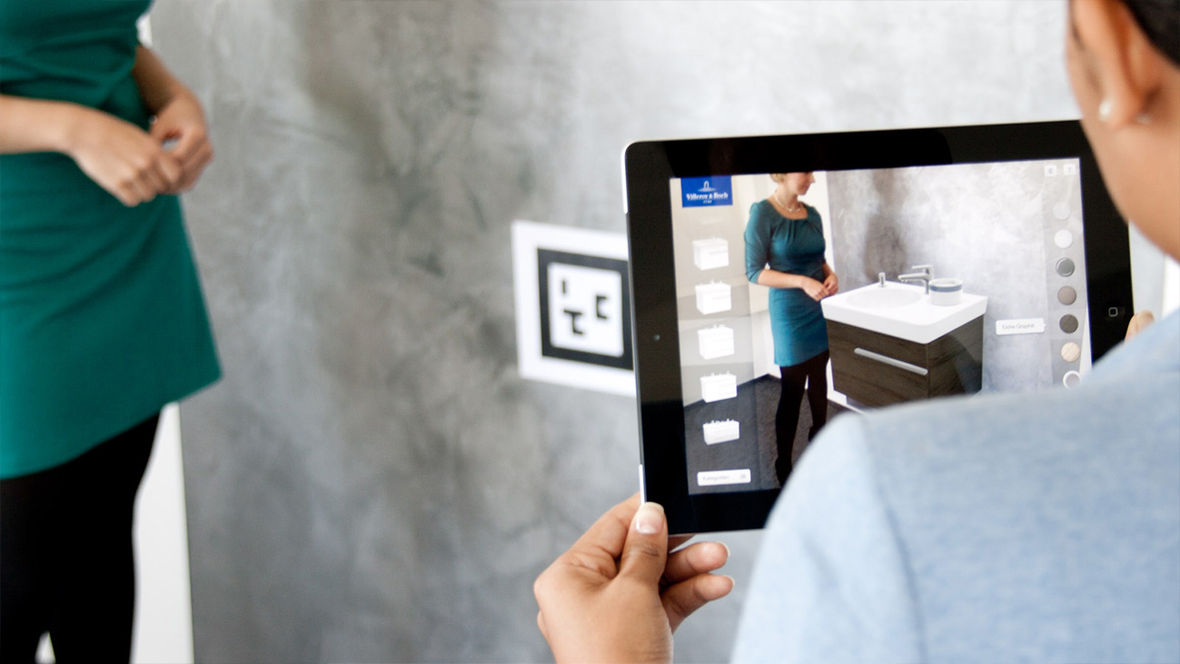
Augmented Reality
Daniel Daugherty, Kevin Guo, Cedric Kim, Kevin Zhang

Slide 2
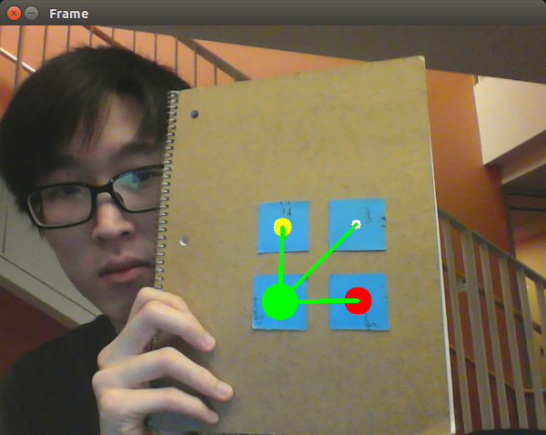
Processing Sticky-Notes
Create contours
Grab center of contours
Process main corner of stick-note layout
Use math/ quadrants to identify and label each corner
Draw lines

Slide 3
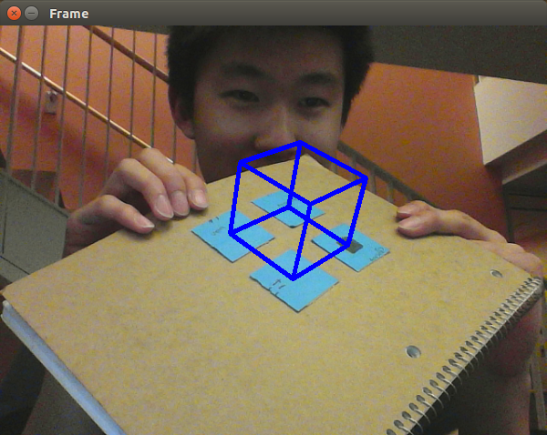
Camera Calibration & 3D projection
Camera Calibration
3D-2D point correspondence
Project Points
Draw Cube (definitely not with MSpaint)

Slide 4
Questions
How do you combine OpenGL and OpenCV images?

Slide 5
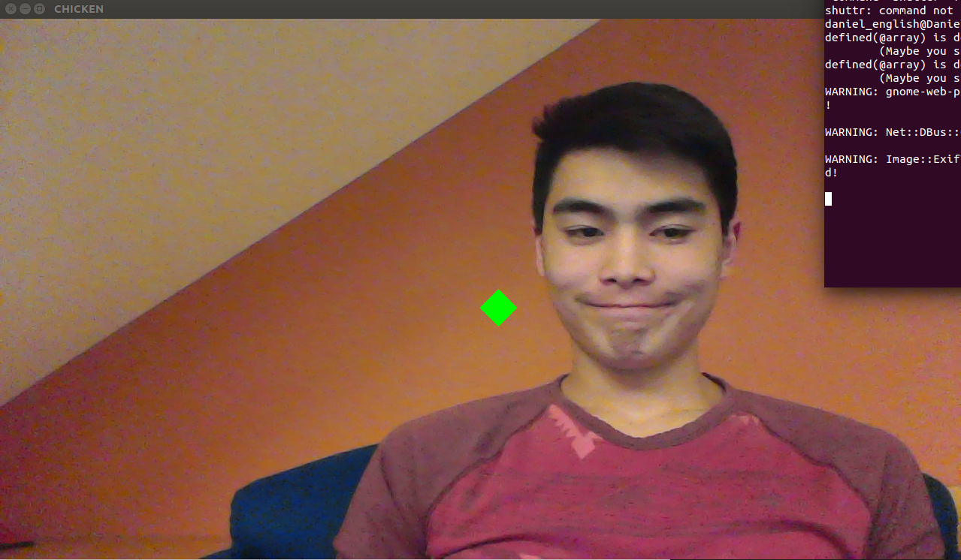
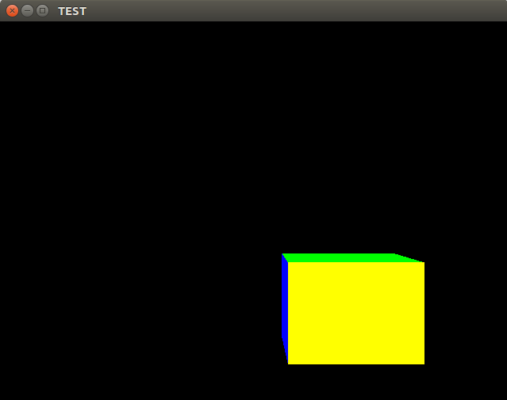
Rendering a Cube on top of an OpenCV Video Feed
Convert OpenCV numpy array to OpenGL format
Zero Latency!
Render a cube on top of the frame

Slide 6
Questions
How do you use both gluPerspective() and gluOrtho2D() to draw a 3D cube on a 2D texture?
How do you render an STL file in OpenGL
Are there any alternatives besides using a virtual machine for our project?

Slide 7
Next Steps
Use different color sticky note instead of black marker
send camera and perspective data from OpenCV to OpenGL
Import STL into OpenGL

Slide 8
Questions?
Comments too!

